Slide 1



US Customer Golden Record

Slide 2
Golden Record 101
A Golden Master Record is the most accurate, complete and comprehensive representation of a master data asset – for the current scope, a Customer.
Why do we need a Golden Record?
Golden Profile –
List of attributes (or fields) that define a Customer uniquely
Have a comprehensive, unambiguous, reliable, and up-to-date view of a Customer
Match & Merge –
To resolve conflict if different pieces of information are present in different applications for the same worker
If a single application does not offer all the necessary attributes, define merge rules
Compatibility and Accessibility –
To ensure the data integration services include the ‘right’ set of data elements to share with internal & external applications
Provide easy data access
Enable reliable reporting & data visualisation
Single workforce view –
avoid duplicates and ensure we have a comprehensive, unambiguous single version of truth
Enhanced Security –
Minimise risk of data breach due to information access for workers who are no longer part of the organisation

Slide 3
US Customer Golden Master Record
Billing Account
Customer
Other Identifiers
Billing Account Identifier
Account Status
Enterprise Customer Identifier
SSN/TIN
CRIS Source Identifier
CSS Source Identifier
Effective/Start Date
Termination/End Date
Date Of Birth
First Name
Other Identifiers
Last Name
Middle Name
Account Contact
Name Prefix
Name Suffix
Phone Numbers – Home, Cell, Work
Email Addresses
Full Name
Customer Status
Next MVP Master Data Scope
Company Business Name (DBA)
Company Legal Name
Premise
Meter
Location
Customer Type – Individual, Company
Customer Contact Preference
Products
Address Type – Bill Service etc
Address Line 1
Customer Programs
Customer Plans
Customer Contact
Service Account
Company Hierarchy
Address Line 2
City
Phone Numbers – Home, Cell, Work
Email Addresses
Customer Segments/ Demographic
State
Zip
Legend
Entity in Scope for MVP1 Scope
Reference Data Attribute in Scope
MVP1 Attribute in Scope
Entity in Scope for Future/Next MVPs
Notes:
Bottom-up view of enabling Data Capabilities in support of prioritized business capabilities
- Iterative approach to building out capabilities incrementally though data enablement – Clean data available and under management - Master Data managed under MDM and both Master and Transaction Data Available within the Data Hub
Business Capabilities sequencing and timelines are still subject to Top-Down Analysis under the Program Governance & Alignment and Technology Solutioning Towers (taking place over the next 3-4 months, but subject to funding)
- Programs need to re-align priorities and release plan, cross-program gaps and dependencies need to be revisited and programs must be funded and resourced accordingly. This is especially impacted by program gaps in CRM and Automated
Marketing capabilities
- Note: CRM and Marketing Automation Completes in Dec 2022
Timelines for many of the required business capabilities extend beyond May-2022 which are being driving by process and tech changes
Some Capabilities that the Blueprint suggests will be dependent on a step change in platform can begin to be enabled by a Step change in data (e.g. Billing Insights). Other such as (New Service Connect) will obviously be clearly be dependent on AMI service

Slide 4
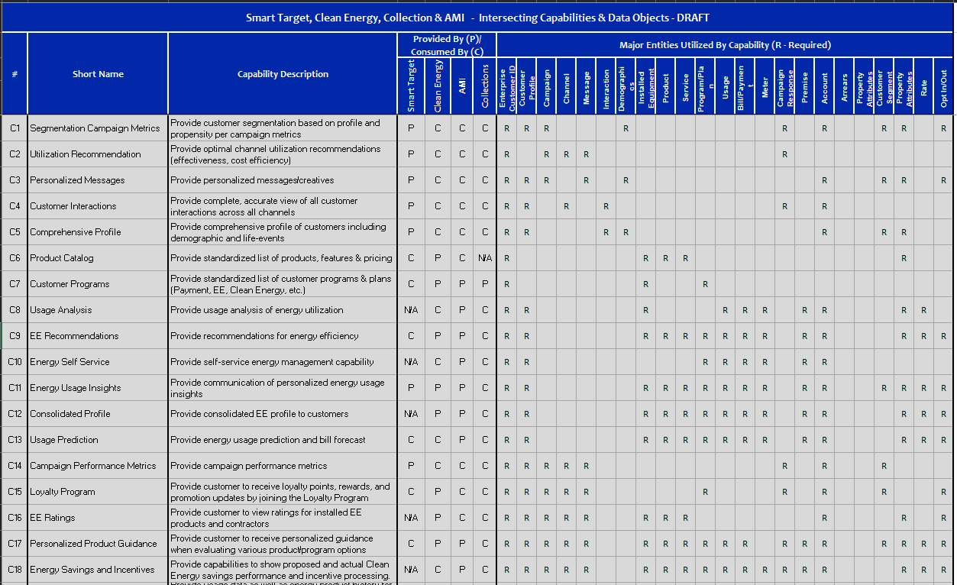
US Customer Capabilities by Programs

Slide 5

US Customer Business Capabilities Proposed Roadmap (OLD)
Delivery / Value Streams:
Data Management Foundational
Customer Data Foundational
Customer Data Integration Services
2021
2022
May
Jun
Jul
Aug
Sep
Oct
Nov
Dec
Jan
Feb
Mar
Apr
May
Jun
Jul
Aug
Sep
Oct
Nov
Dec
Releases:
MVP R1
MVP R2
MVP R3
MVP R4
Business Capabilities Support
Informatica Catalog, Governance and Quality Tools available
C13 – Consolidated Profile (Basic)
C8 – Customer Programs
C1 – Segmentation Campaign Metrics
C3 – Personalized Messages
C9 – Usage Analysis
C2 – Utilization Recommendation
C4 – Customer Interactions
Reltio MDM and Matillion Tools available
C14 – Usage Prediction
C5 – Comprehensive Profile
C15 –Campaign Performance Metrics
C10 – EE Recommendations
C8 – Customer Programs
C16 – Loyalty Program
C11 – Energy Self Service
C12 – Energy Usage Insights
CRIS and CSS CDC (for MVP1)
CRIS and CSS CDC (for MVP2)
C17 – EE Ratings
C18 – Personalized Product Guidance
C20 – Usage History
C19 – Energy Savings and Incentives
C22 – Proactive Usage Feedback
C21 – Enrollment Offers
C7 – Product Catalog
C23 – Outage Status
C25 – Customer Balance
MDM (Reltio)
Customer Data model, Data Catalog, Data Governance, Data Quality Profiling, CDC, Business Rules/Requirement
Persistent ID (leverage UDM) , Key Customer Profile and contact fields, Service Account
Preference, Premise, Billing Account, Meter, Products
Customer, Segments,
Customer Programs/Plans, Company Hierarchy
CDP (Snowflake) - Enterprise
Persistent ID (leverage UDM) , Key Customer Profile and contact fields, Service Account
Bill/Credit/Payment, Usage,
Preference, Premise, Billing Account, Meter
Customer Segments,
Customer Program/Plan, Campaign, Campaign Response, IVR
Customer Interaction,
Messages, Addition Customer Data
CDP (Snowflake) - Raw/Staging
Premise, Meter, Billing Account, Bill, Credit, Payment, Usage, IVR, Meter, Segment, Campaign
Notes:
Bottom-up view of enabling Data Capabilities in support of prioritized business capabilities
- Iterative approach to building out capabilities incrementally though data enablement – Clean data available and under management - Master Data managed under MDM and both Master and Transaction Data Available within the Data Hub
Business Capabilities sequencing and timelines are still subject to Top-Down Analysis under the Program Governance & Alignment and Technology Solutioning Towers (taking place over the next 3-4 months, but subject to funding)
- Programs need to re-align priorities and release plan, cross-program gaps and dependencies need to be revisited and programs must be funded and resourced accordingly. This is especially impacted by program gaps in CRM and Automated
Marketing capabilities
- Note: CRM and Marketing Automation Completes in Dec 2022
Timelines for many of the required business capabilities extend beyond May-2022 which are being driving by process and tech changes
Some Capabilities that the Blueprint suggests will be dependent on a step change in platform can begin to be enabled by a Step change in data (e.g. Billing Insights). Other such as (New Service Connect) will obviously be clearly be dependent on AMI service

Slide 6
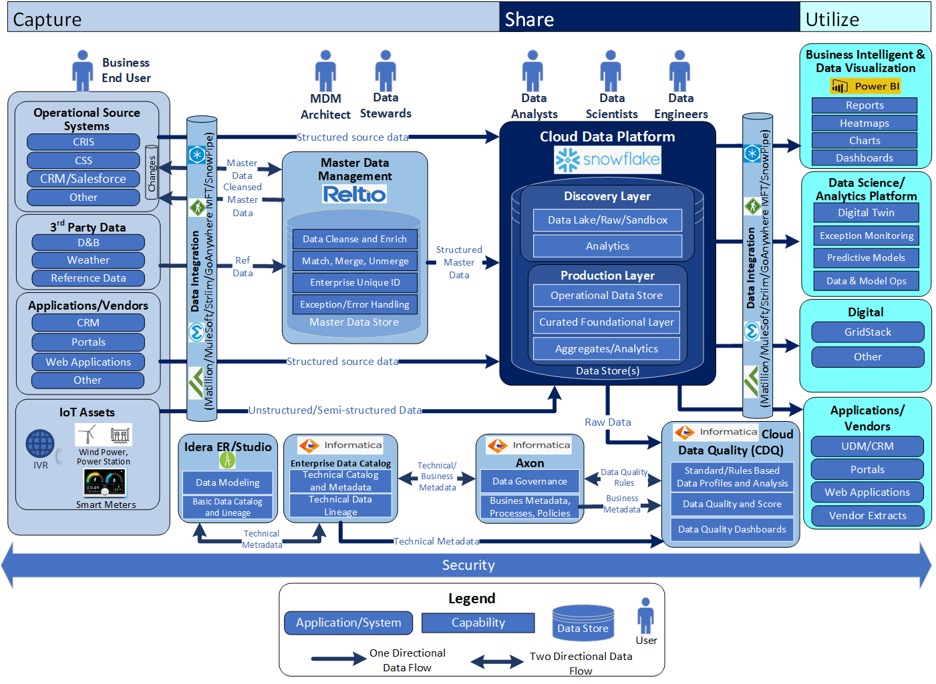
US Customer Data Platform Architecture
Notes:
Bottom-up view of enabling Data Capabilities in support of prioritized business capabilities
- Iterative approach to building out capabilities incrementally though data enablement – Clean data available and under management - Master Data managed under MDM and both Master and Transaction Data Available within the Data Hub
Business Capabilities sequencing and timelines are still subject to Top-Down Analysis under the Program Governance & Alignment and Technology Solutioning Towers (taking place over the next 3-4 months, but subject to funding)
- Programs need to re-align priorities and release plan, cross-program gaps and dependencies need to be revisited and programs must be funded and resourced accordingly. This is especially impacted by program gaps in CRM and Automated
Marketing capabilities
- Note: CRM and Marketing Automation Completes in Dec 2022
Timelines for many of the required business capabilities extend beyond May-2022 which are being driving by process and tech changes
Some Capabilities that the Blueprint suggests will be dependent on a step change in platform can begin to be enabled by a Step change in data (e.g. Billing Insights). Other such as (New Service Connect) will obviously be clearly be dependent on AMI service

Slide 7
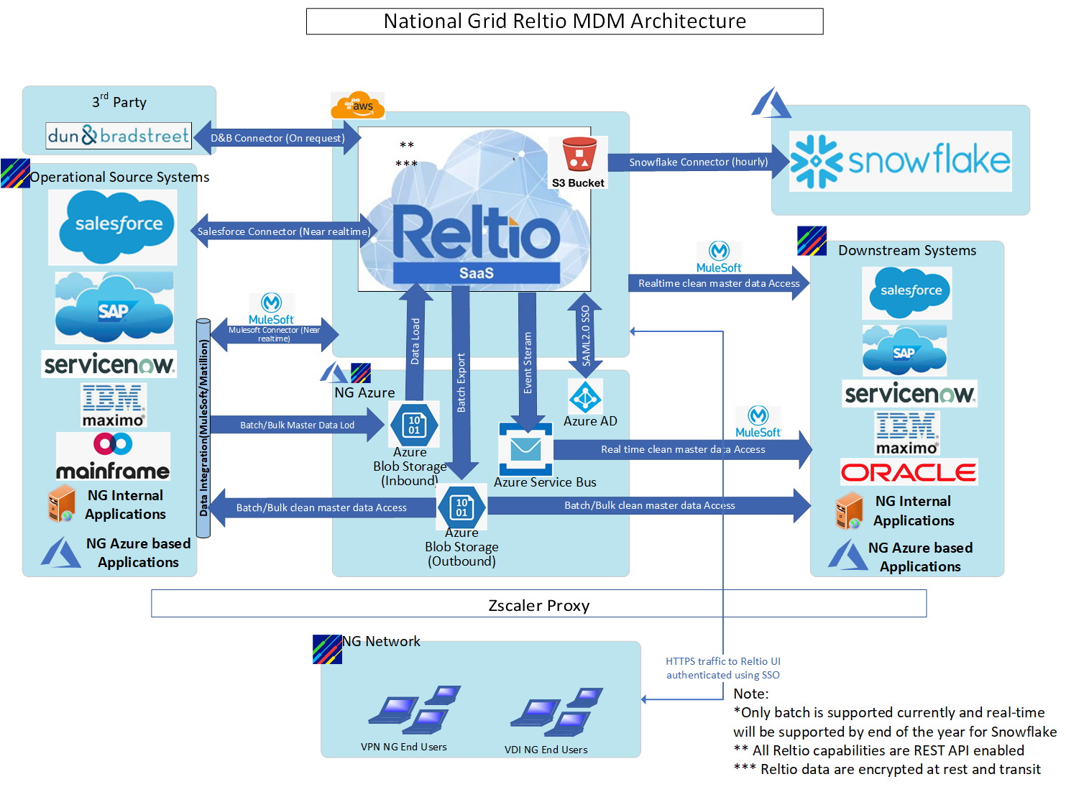
MDM Architecture
Notes:
Bottom-up view of enabling Data Capabilities in support of prioritized business capabilities
- Iterative approach to building out capabilities incrementally though data enablement – Clean data available and under management - Master Data managed under MDM and both Master and Transaction Data Available within the Data Hub
Business Capabilities sequencing and timelines are still subject to Top-Down Analysis under the Program Governance & Alignment and Technology Solutioning Towers (taking place over the next 3-4 months, but subject to funding)
- Programs need to re-align priorities and release plan, cross-program gaps and dependencies need to be revisited and programs must be funded and resourced accordingly. This is especially impacted by program gaps in CRM and Automated
Marketing capabilities
- Note: CRM and Marketing Automation Completes in Dec 2022
Timelines for many of the required business capabilities extend beyond May-2022 which are being driving by process and tech changes
Some Capabilities that the Blueprint suggests will be dependent on a step change in platform can begin to be enabled by a Step change in data (e.g. Billing Insights). Other such as (New Service Connect) will obviously be clearly be dependent on AMI service

